Slide 1
HYBRIS: ACCelerator week 9
Task 9.4 - (Accelerator):
Task: Think of a short name for a new store (for example, estore). Create a separate codebase for your store using modulegen. Create project data for the new module.
Start Hybris with generated extensions. Ensure that your new store is displayed without errors after initialization.

Slide 2
Steps what I did: 1. Run ant modulegen with the following parameters: template: accelerator name: apple package: org.training 2. Add extensions to the localextensions.xml file <extension name="applefulfilmentprocess"/> <extension name="applecore"/> <extension name="appleinitialdata"/> <extension name="applefacades"/> <extension name="appletest"/> <extension name="applestorefront"/> <extension name="applecockpits"/> 3. Run ant clean all 4. Start the server 5. Update the system with project data 6. Add new entries to the host file: 127.0.0.1 electronics.local 127.0.0.1 apparel-uk.local 127.0.0.1 apparel-de.local
Implementation details

Slide 3
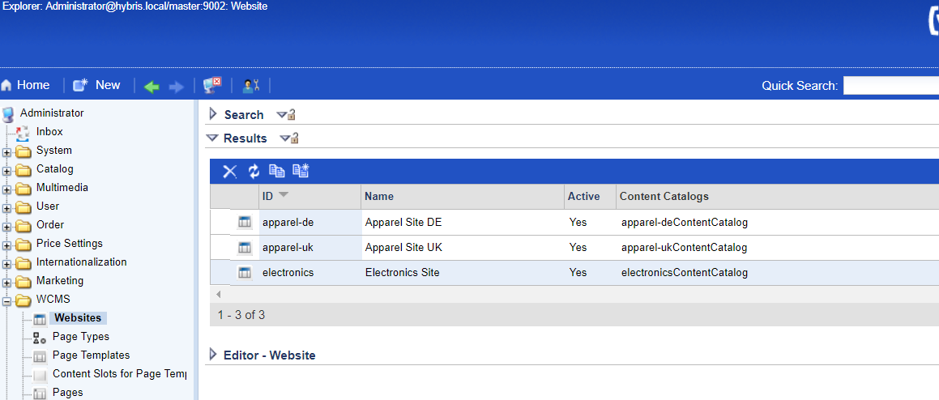
I can see the sites in HMC.
Verification

Slide 4
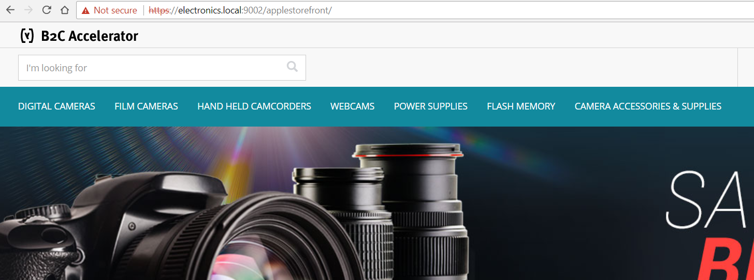
I can see the sites in the browsers.
Verification

